Slide 1
Proteomics
modified from: Alexey I. Nesvizhskii

Slide 2
Learning Objectives
To learn about proteomics and different strategies for identifying and analyzing protein sequences
To learn about peptide fragmentation strategies and metrics

Slide 3
Proteins
Make up about 15% of the cell
Have many functions in the cell
Enzymes
Structural
Transport
Motor
Storage
Signaling
Receptors
Gene regulation
Special functions

Slide 4
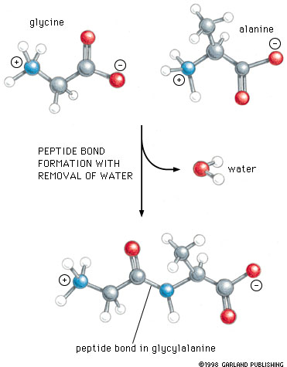
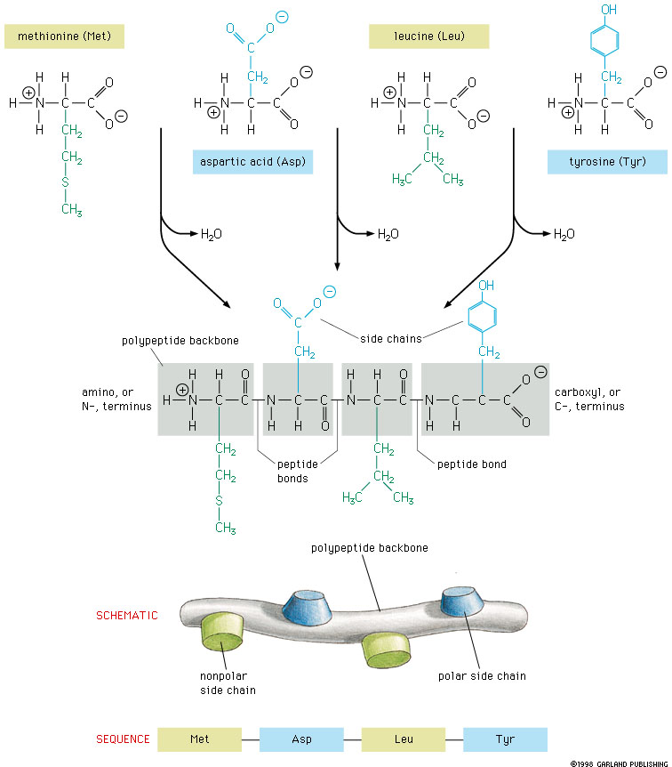
Polypeptide Backbone

Slide 5
Proteins and Proteomics
Proteins are the action molecules of the cell and the leading candidates for biomarkers - in tissues and in the blood. The primary amino acid sequence of proteins is coded for by triplets of nucleotides in the exons of genes. Understanding one protein can be a lifetime’s work!
Proteomics is the global analysis of proteins in cells, tissues, or body fluids. Techniques for global analysis of proteins are advancing rapidly.

Slide 6
Rationale for Proteomics Studies
Proteins (and even more so metabolites) are much closer to the pathophysiologic changes and molecular targets for drugs than are mRNAs.
Changes in mRNAs are clues, but changes in corresponding proteins often are not highly correlated.
Recent advances in protein fractionation, in mass spectrometry, in microarrays with protein capture agents,
and in curated databases of proteins enable large-scale interrogation of the proteomes

Slide 7
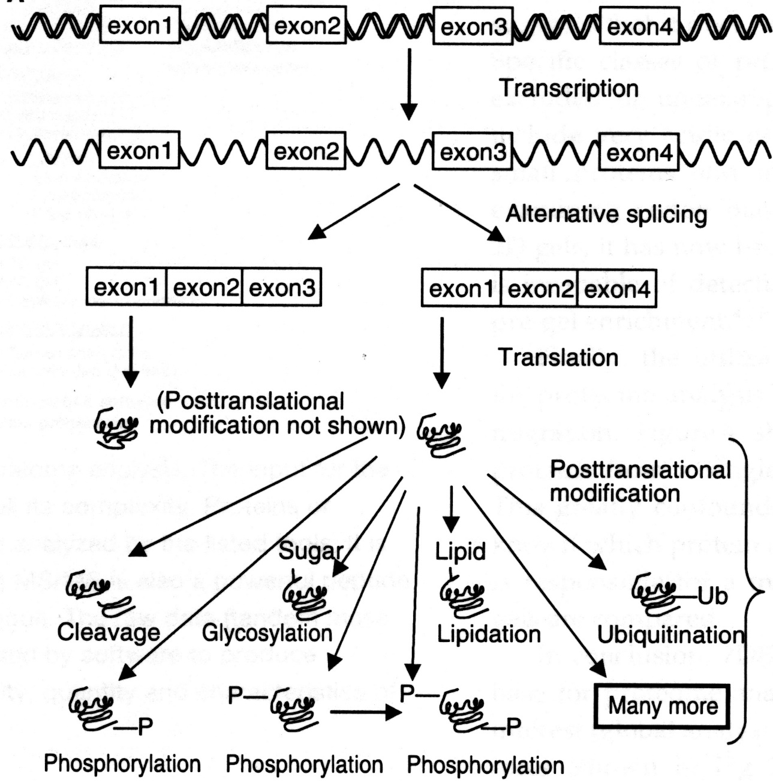
DNA
Genome
mRNA
Transcriptome
Proteins
Modified
Proteins
Proteome
Notes:
7

Slide 8
Types of Biological Information
List of open reading frames (ORFs).
List of splice forms.
List of modified proteins.
Protein expression profile.
Spatial distribution.
Protein interaction map.
Functional linkage map.
Binding constants.

Slide 9
Technology Platforms for Proteomics
Mass spectrometry (MS)
Several distinct classes of MS instruments
Also, technologies for separation (2-D gels, 2-D LC), affinity purification, protein labeling, fractionation etc.
Protein microarrays, generally using antigen-antibody specificity for detection
Yeast two hybrid, phage displays, etc.

Slide 10
Applications of Mass Spectrometry-based Proteomics Technology
Parts list: cataloguing all gene products, including splice forms, fusion proteins etc.
Post-translational modifications and their biological functions (phosphorylation, glycosylation, proteolytic cleavages, etc)
Differential expression: analysis of protein expression profiles as a function of cellular state as an aid to infer cellular function/pathways
Biomarkers: finding peptides and proteins in tissues and bodily fluids (plasma, urine, etc.) that are markers of a human disease
Interactomes: protein-protein interactions, protein complexes

Slide 11
Sample preparation and peptide separation
depletion/
enrichment
digestion
separation
*
1
Depleted/enriched
peptide sample
12
14
16
Sample
Peptides
Time (min)
Separated peptides
Mass spectrometry
2
*
MS/MS
Fragment
peptide
Q1
Q2
Collision Cell
Q3
200
600
m/z
1200
Tandem mass spectrum
3
Peptide identification
200
600
1200
sequence database
matching
200
600
1200
m/z
m/z
Theoretical
Acquired

Slide 12
Peptide fragmentation
A-P-N-D-F-N-L-K
(MH+ 918.5)
B-ions Y-ions
72.0 A P-N-D-F-N-L-K 847.4
169.1 A-P N-D-F-N-L-K 750.4
283.1 A-P-N D-F-N-L-K 636.3
398.2 A-P-N-D F-N-L-K 521.3
545.2 A-P-N-D-F N-L-K 374.2
659.3 A-P-N-D-F-N L-K 260.2
772.4 A-P-N-D-F-N-L K 147.1
b-ions = ΣAA + H⁺
y-ions = ΣAA + H₂O + H⁺
monoisotopic masses

Slide 13
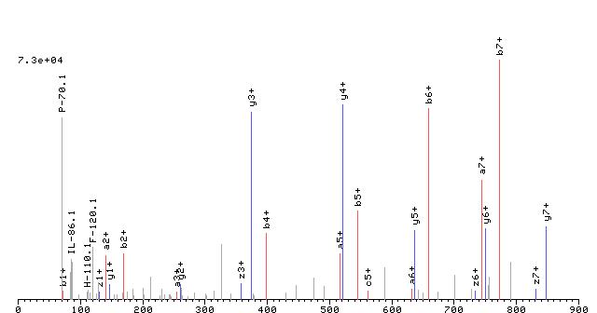
Sequence vs. tandem mass spectrum
A-P-N-D-F-N-L-K
(MH+ 918.5)
A
P
N
D
F
N
L
K
K
L
N
F
D
N
P
A

Slide 14
Computational Methods
Database searching
Spectrum library searching
De novo
Hybrid methods (automated de novo sequencing combined with sequence database searching)

Slide 15
MS/MS Database Search
Q
V
S
V
V
D
L
T
N
T
R
Protein sequence
database
MS/MS
Acquired spectrum
Theoretical spectrum
compare
ISLLDAQSAPLR
VVEELCPTPEGK
LLLQWCWENGK
CDVVSNTIIAEK
GDAVFVIDALNR
QVSVVDLTNTR
SYLFCMENSAEK
200
400
600
800
1000
1200
200
400
600
800
1000
1200
m/z
m/z
Rank Peptide Score S
1 VSTPNVSVVDLTCR 3.3
2 VVEELCTPEGMK 2.1
3 DLLLQWCWENGIK 1.9
4 ECDVVSNTIIAEK 1.7
5 GDAVFVIDALNR 1.6
…
n SYLFCMEAEK 0.2
Ranked list of
peptide matches
Best match could be true or
false identification

Slide 16
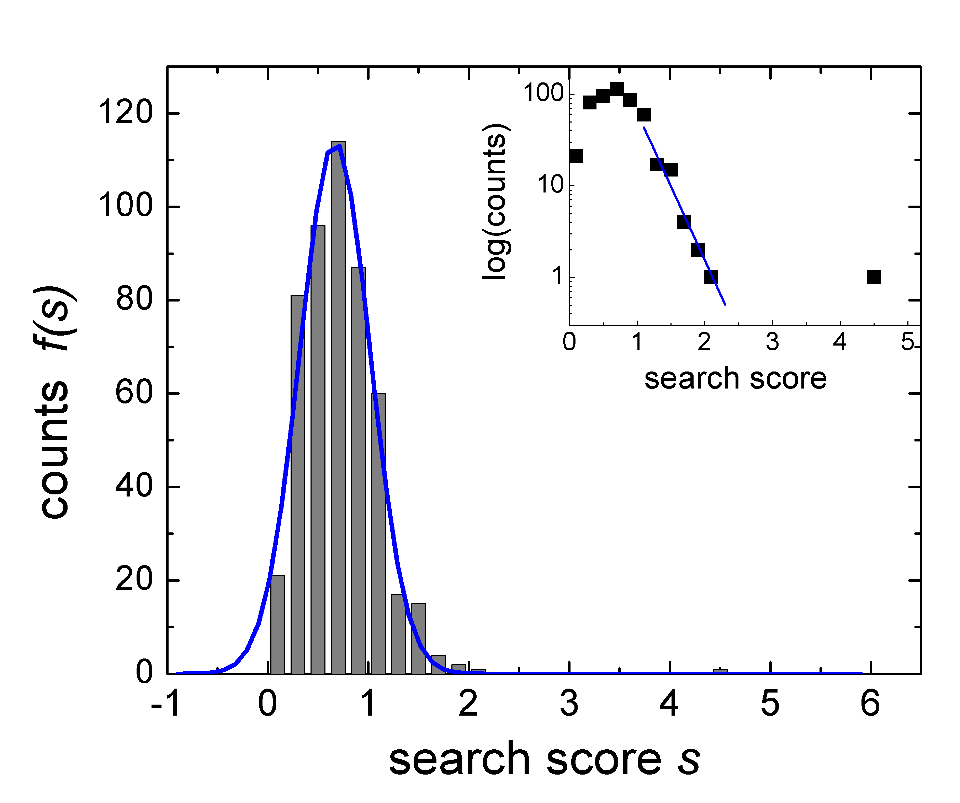
Expectation Values (empirical model)
probability to get score s ≥ s_{m} by chance
Spectrum
Database
expected number of
random matches
with s ≥s_{m}
ISLLDAQSAPLR
VVEELCPTPEGK
DLLLQWCWENGK
ECDVVSNTIIAEK
GDAVFVIDALNR
VPTPNVSVVDTNR
SYLFCMENSAEK
PEQSDLRSWTAK
m/z
SEQUEST Xcorr score
Rank Peptide Score
1 ISLLDAQSAPLR 4.5
2 VVEELCTPEGK 2.1
3 DLLLQWCWENGK 2.0
4 ECDVVSNTIIAEK 1.9
5 GDAVFVIDALNR 1.7
6 VPTPNVSVVTNR 1.6
7 SYLFCMEAEK 1.6
8 PEQSDLRSWTAK 1.5
...
p
10⁻⁵
0.11
0.23
0.52
0.72
0.86
0.86
0.94
…
N P(s)
top hit
s_{m}
N peptides

Slide 17
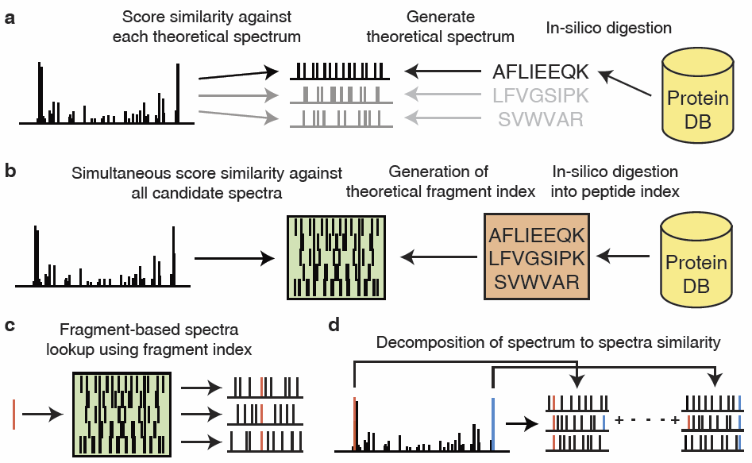
MSFragger Algorithm
Kong AT et al, 2017. Nature Methods

Slide 18

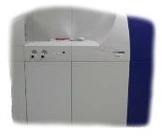
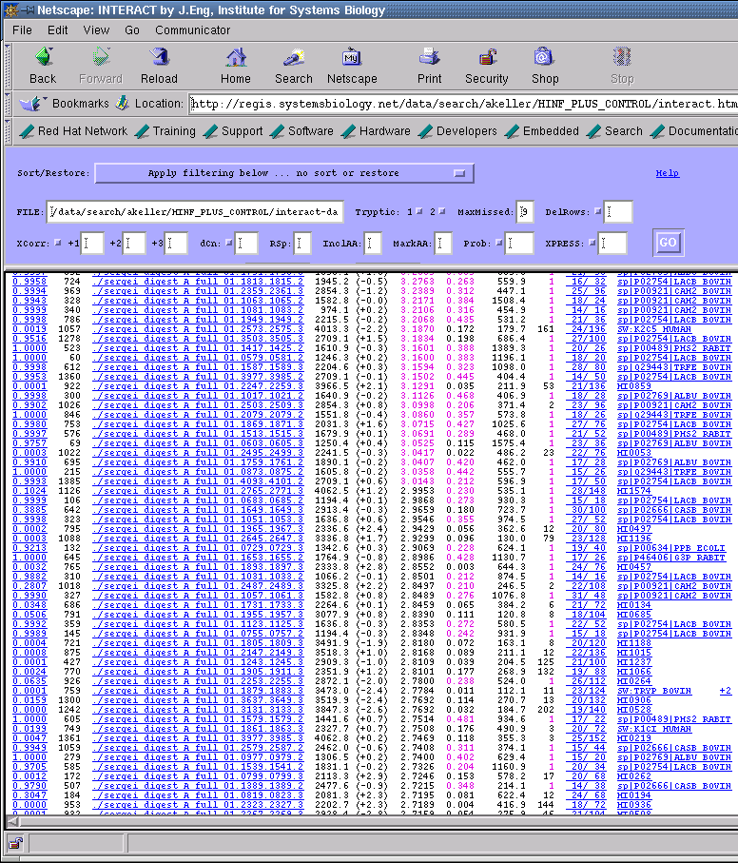
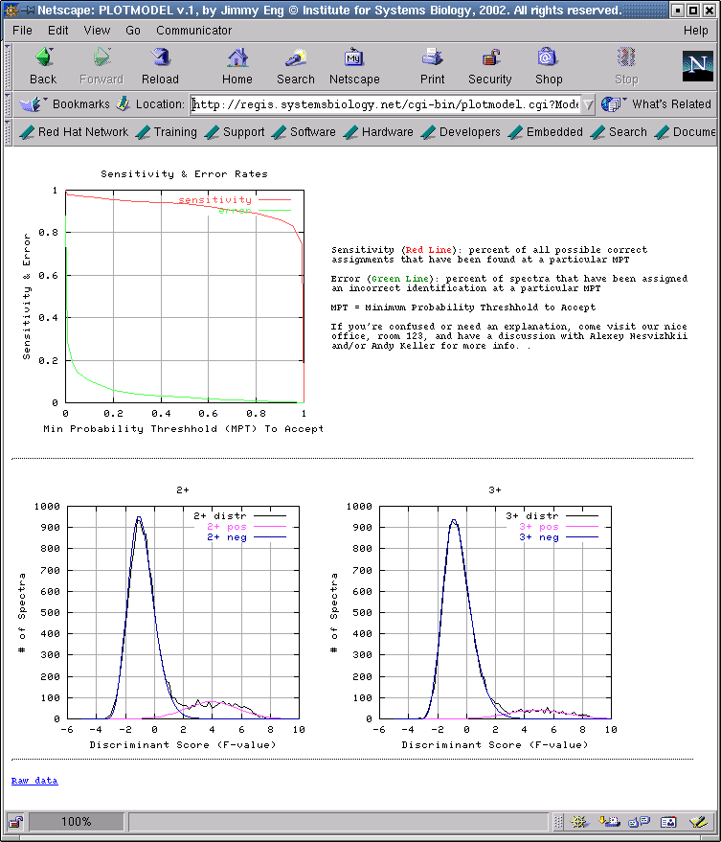
Goal of Statistical Analysis
Study 1
Study 2
different MS platforms,
protocols,
peptide identification tools
LTQ
TOF-TOF
Q-TOF
unknown error rates
datasets hard to compare
SEQUEST
MASCOT
Statistical modeling
known error rates
objective comparison
Peptide/protein identifications
with posterior probabilities/FDR

Slide 19
spectra
database
search
spec peptide score label
1 ISLLDAQSAPLR 4.5 target
2 VVEELCTPEGK 3.9 target
5 GDAVFVIDALNR 3.6 target
3 VNSPMKWVVPTPK 1.7 decoy
4 ECDVVSNTIIAEK 1.5 target
…
N LIHSVFGIGEK 1.1 decoy

